Slide 1

-Classified-

Slide 2
Storyline
War is upon us. Your Mission is Simple
You have been tasked with collecting ammunition for war effort. The situation is complicated, and you must stay together at all times
Because the CCTVs have been disabled, you will need to take a level picture after collecting ammunition to show that you are safe. We cannot risk losing anymore warriors.
GOOD LUCK

Slide 3
Y4 Level Activity
-Snakes
-Level Photo
Notes:
Storyline: When transporting the supplies, you have accidentally spilled the ammunition onto the ground and you now need to recover them. However, as these are dangerous parts, you need to stick together with your class to retrieve the bullets on the ground successfully.

Slide 4
Timeline
Time | Description of Activity | Location
0930 - 0950 | Briefing by Class Facils + Class discussion time | Classroom
0950 - 1010 | Break | -
1010 - 1125 | Snake Activity | Field
1125 - 1145 | Level Photo-taking + Pack Up | Field
1145 - 1200 | Buffer | -

Slide 5
Set up
Each class is allocated a “base” (hula hoops) on the field
Before the game:
Class to decide on the “head” of the snake (i.e. the person walking around to collect “Power Points” and to attack other snakes)
During the game:
“Head” will start at base, all other members distributed around the field by OGL
“Power Points” (i.e. Ping Pong Balls) will be scattered on the field

Slide 6
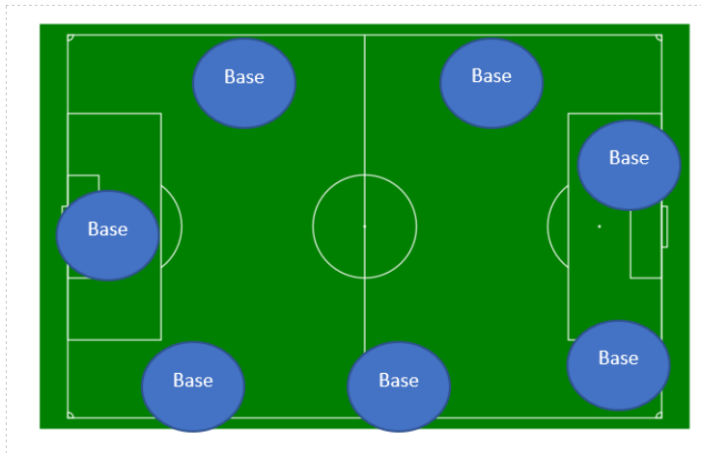
Set up
Each class will be assigned a base to do forfeits

Slide 7
Objective of the Game
To get the longest snake and collect the most “Power Points”
“Heads” to walk around the field to “pick up” members of their class
Min. length of 4 members (including the “Head”) before “Power Points” can be picked up by the “Head”
ONLY the “HEAD” is allowed to obtain “Power Points” (i.e. pick up Ping Pong Balls) -> Bucket will be provided

Slide 8
Gameplay
Basic gameplay
Snake “heads” walk around to pick up other members
Minimum length of 4 for snake to start collecting “Power points” and attacking

Slide 9
Attacking and Defending
Attack is initiated when head of a snake taps on anyone in another snake
Every person behind the "head" will then play rock-paper-scissors with the person in the defending snake in a 1 to 1 fashion. This "attack" will end when the last person of either snake is reached.
For each loss from the defending team, 1 power point is transferred over to the attacking team and the person who lost returns to their base where they need to do a forfeit to return back to the playing area.

Slide 10

Example of an attack-Initiation
1
2
3
4
5
6
7
8
2
1
6
5
4
3

Slide 11
Example of an attack-Rock Paper Scissors
1
2
3
4
5
6
7
8
1
2
3
4
5
6

Slide 12
Example of an attack-Conclusion
5
6
8
1
2
3
4
5
6
7
8
7
1
2
3
4
5
6
3 Power Points

Slide 13

Bonuses and Scoring
Bonuses:
We encourage you to form longer snakes at the start of the game
Thus, we will be awarding 10 power points every 5 minutes to the team with the longest snake (3 times in total)
Scoring:
Teams are given 25 minutes to maximize their score
The score can be calculated by:

Slide 14
Photo Taking!
Everyone from the cohort will assemble together on the field
Form " YEAR 4'20 " on the field
A photo of the figure will be taken from above
Key takeaway from Orientation'20 :)

Slide 15
Safety
Safety is Very Important
Things to look out for:
No Running
No Pushing
No Shoving
Hydrate yourselves
If you feel any discomfort, please inform your OGLs and mentor immediately

